Slide 1
Cruise control
Brigosha Associates
Pranav R
Bhoomik
Sahana MS
Kavita

Slide 2
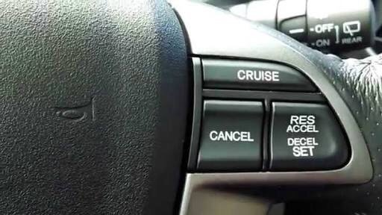
Introduction
Cruise control also known also as speed control. It is a system that automatically/constantly maintain the speed of the vehicle.
Cruise control is a feature that helps reduce such fatigue drivers would feel while driving a long distance.
It allows drivers to keep their vehicle at a constant speed, there is less risk of the driver accelerating and speeding past other drivers.

Slide 3
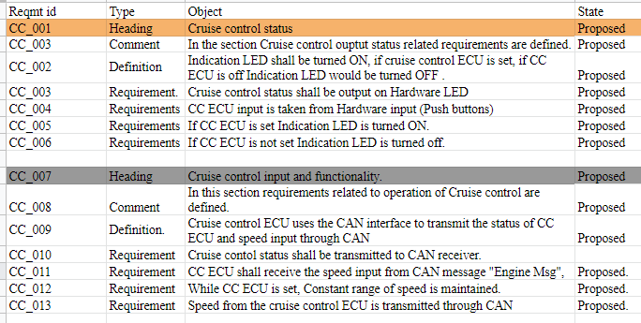
requirements

Slide 4
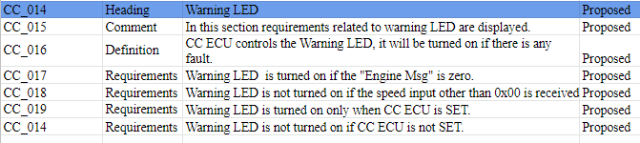
requirements

Slide 5
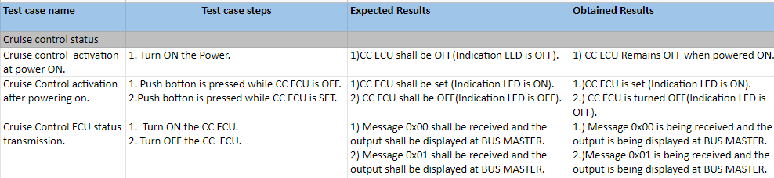
Test cases

Slide 6
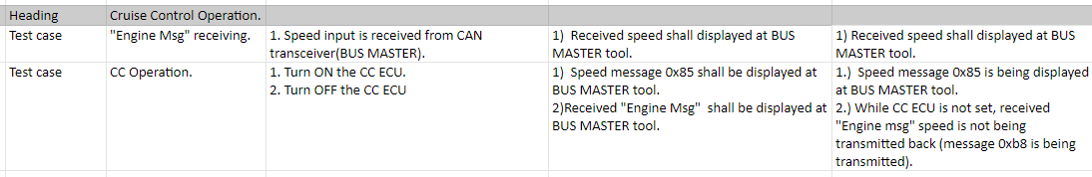
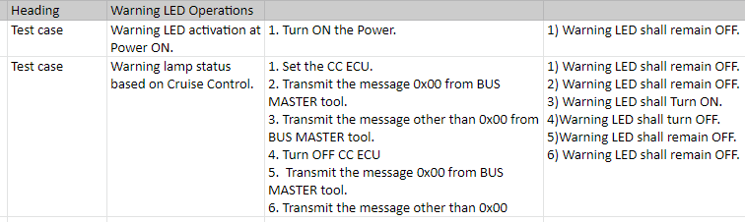
Test cases

Slide 7
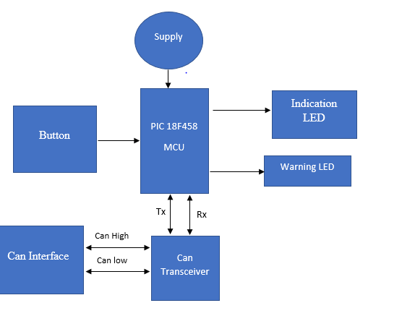
Hardware block diagram

Slide 8
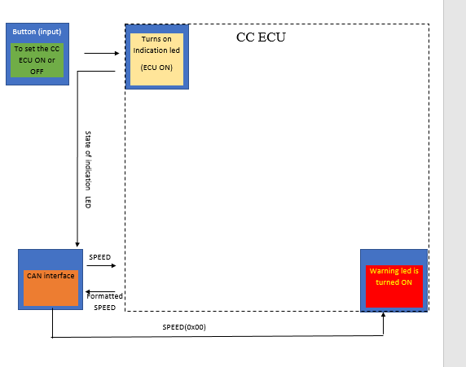
System block diagram

Slide 9
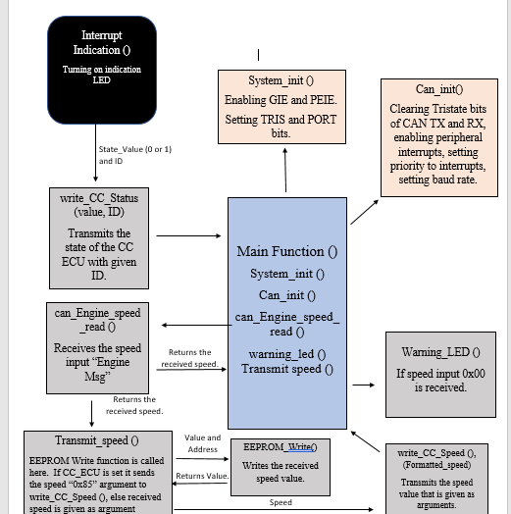
Functional diagram

Slide 10
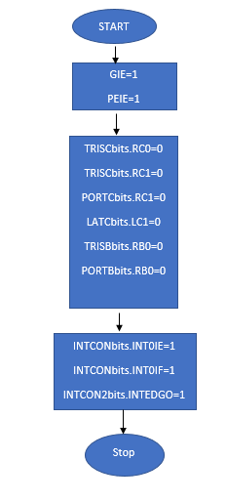
Sequential
SYS IN IT

Slide 11
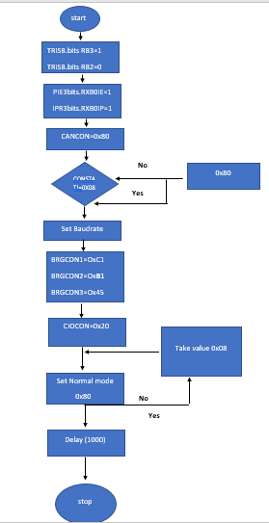
CANINT

Slide 12
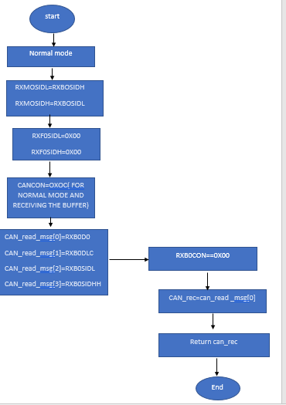
can_Engine_speed_read ()

Slide 13
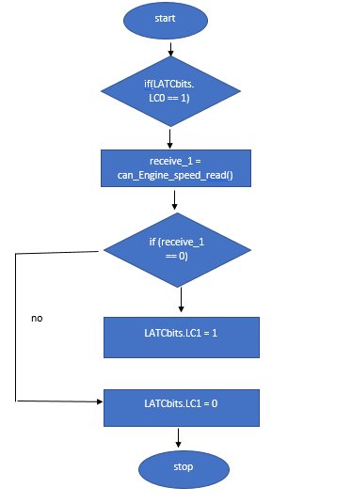
warning_led ()

Slide 14
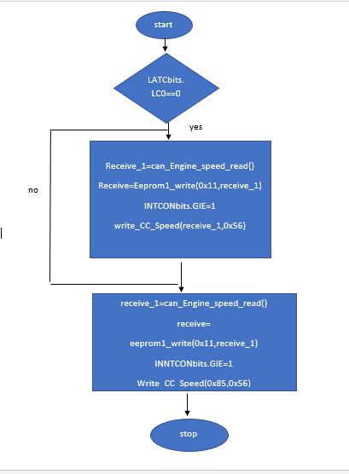
Void transmit_speed

Slide 15
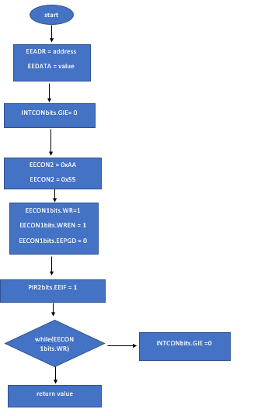
eeprom1_write

Slide 16
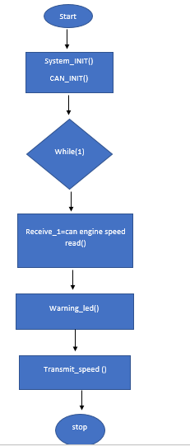
Main ()

Slide 17
Advantages
Keeps the driver tireless.
Since, the engine is running at a constant rpm, the vehicle returns good fuel economy.
Cruise control sticks to speed limit on the particular road, which makes driving safe and pleasant.

Slide 18
disadvantages
Harder to Slow Down Quickly
Harder to Drive in Bad Weather
Easier to Get Distracted
Changing road conditions

Slide 19
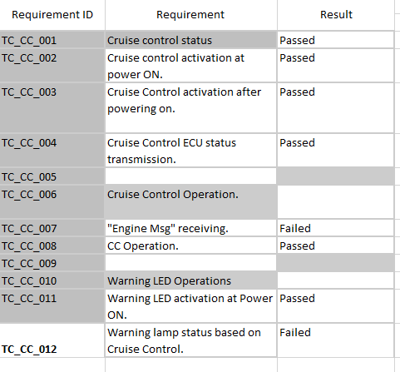
Test Result

Slide 20
Thank you!

